Slide 1

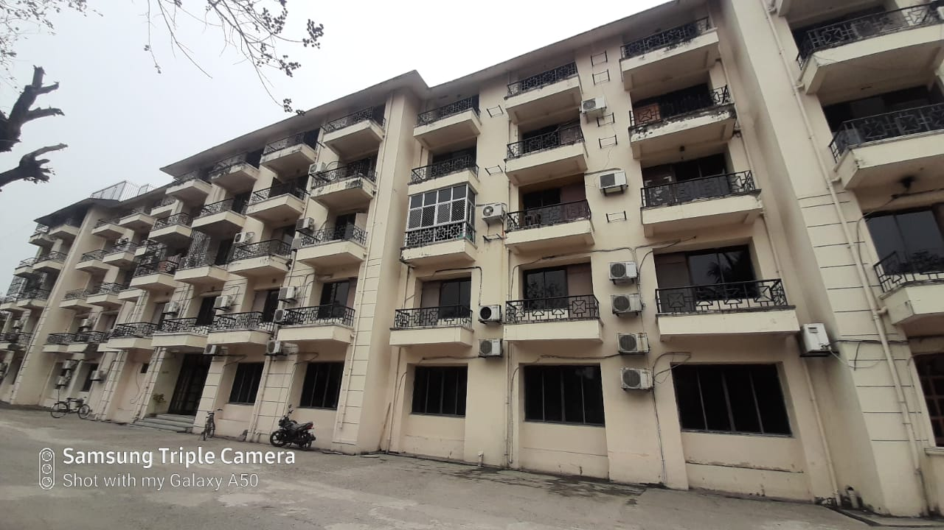


INFORMATION MEMORANDUM
Information Memorandum
Lake Land Country Club. Kona Expressway Garfa, Howrah- 711403
March 2020

Slide 2




Contents
Project Brief
Property Images
Contact Information
Location Analysis
Page 2

Slide 3
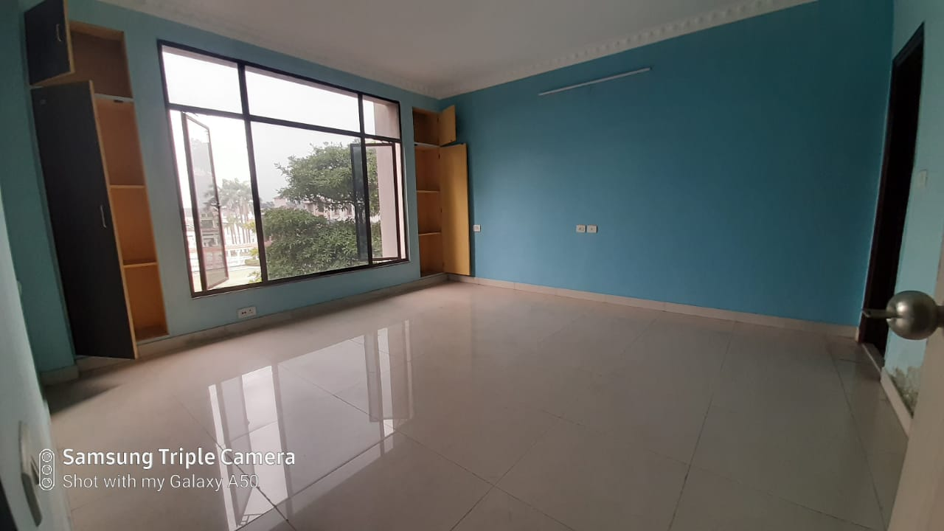
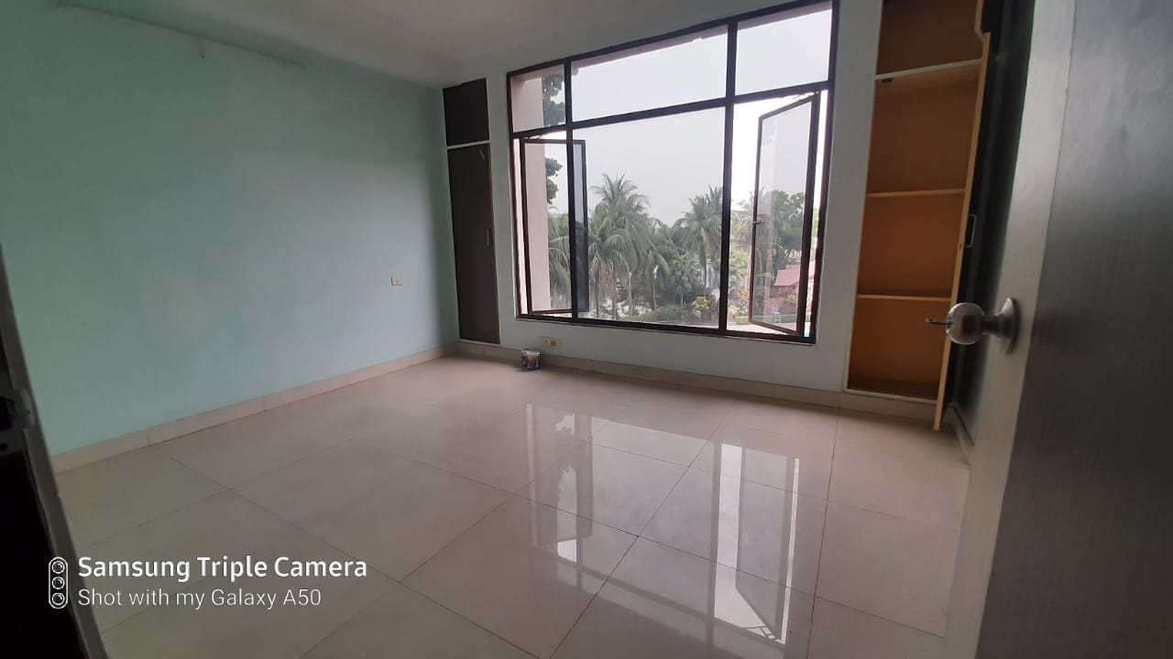
Project Brief
CBRE has been appointed to sell 3 Flats in a G+4 Building at Kona Expressway; Munshidanga, Gorfa, Howrah-711403.
Adjacent to the Fortune Park Panchwati – a 3-star Hotel, Lake Land Country Club is a small gated housing complex comprising of two storied bungalows with children’s park, security, swimming pool etc.
1BHK- 640 SQ FT-3rd floor
1BHK-705 SQ FT- 2nd Floor
2BHK- 1076 SQ FT- 3rd floor
Page 3

Slide 4
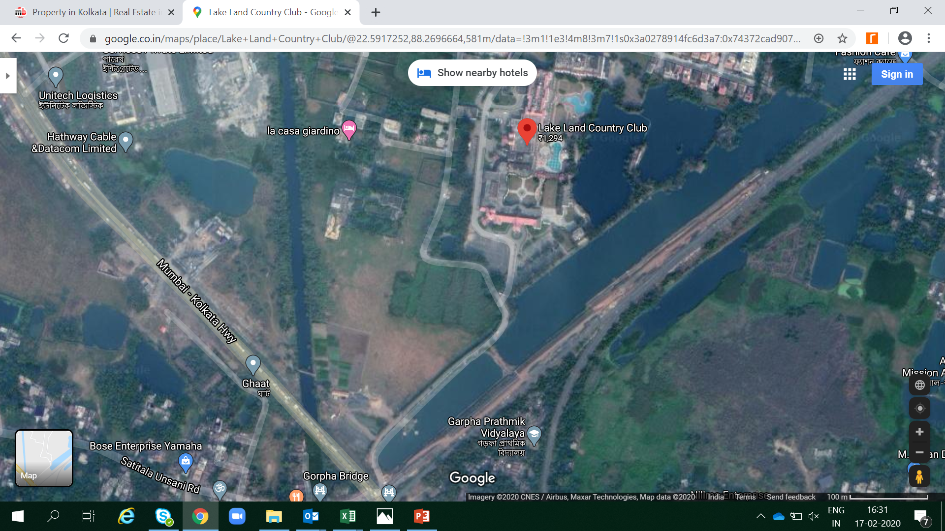
Location Analysis
* Map Not to Scale
Page 4

Slide 5
Location Analysis
Place | Distance (Approx. Kms)
Airport | 27
Howrah Station | 9.4
Santragachi Station | 2.5
Shalimar Station | 8.6
Rabindra Sadan Metro Station | 11.4
Julien Day School, Kona Expressway, Bankra | 2.7
Howrah Maidan | 10
Dalhousie | 10.5
Avani Mall | 7
ESI Hospital | 2.5
Bankra Hospital | 1.4
Vidyasagar Setu | 7.3
Park Street | 11.3
Page 5

Slide 6
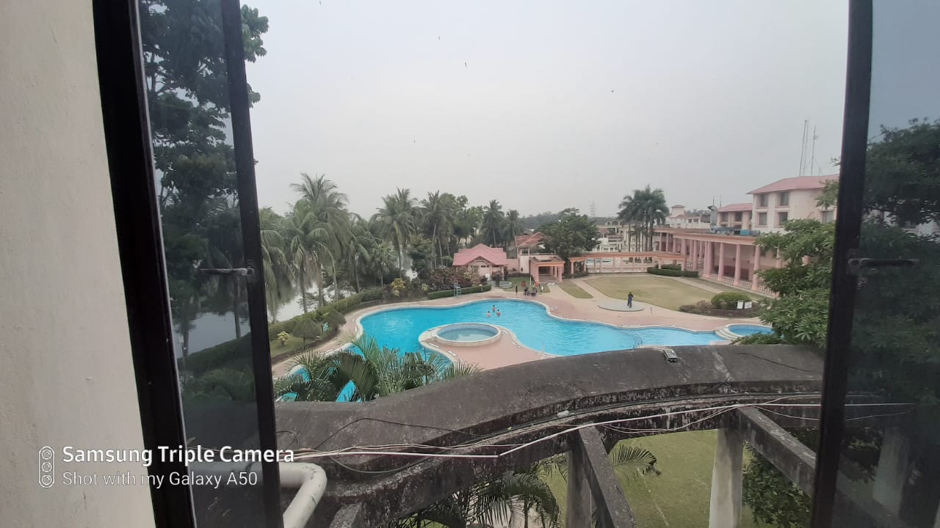
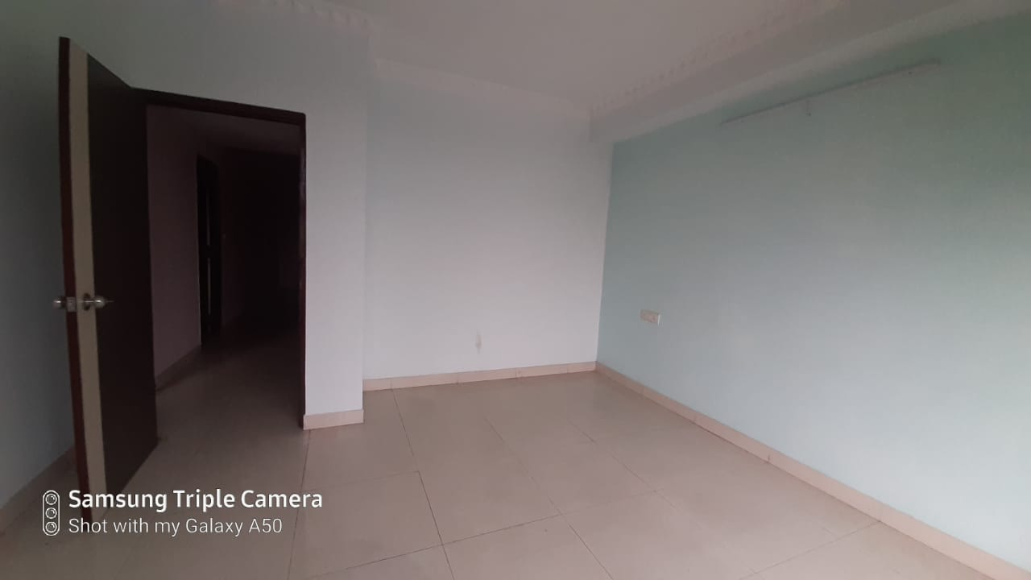
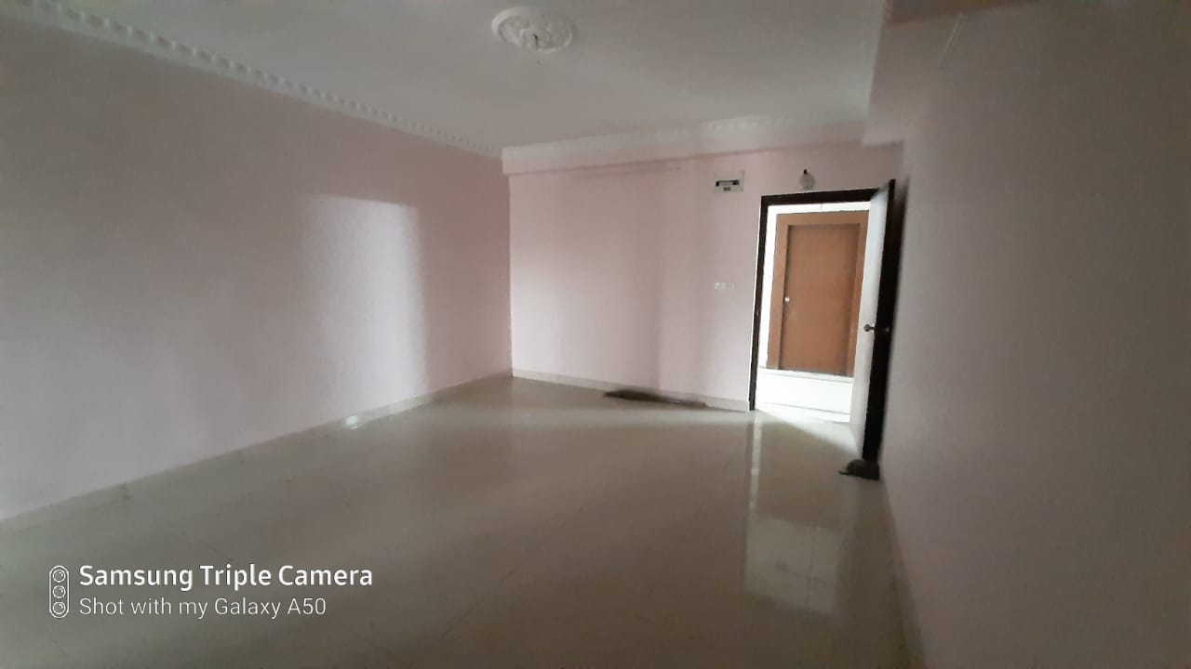
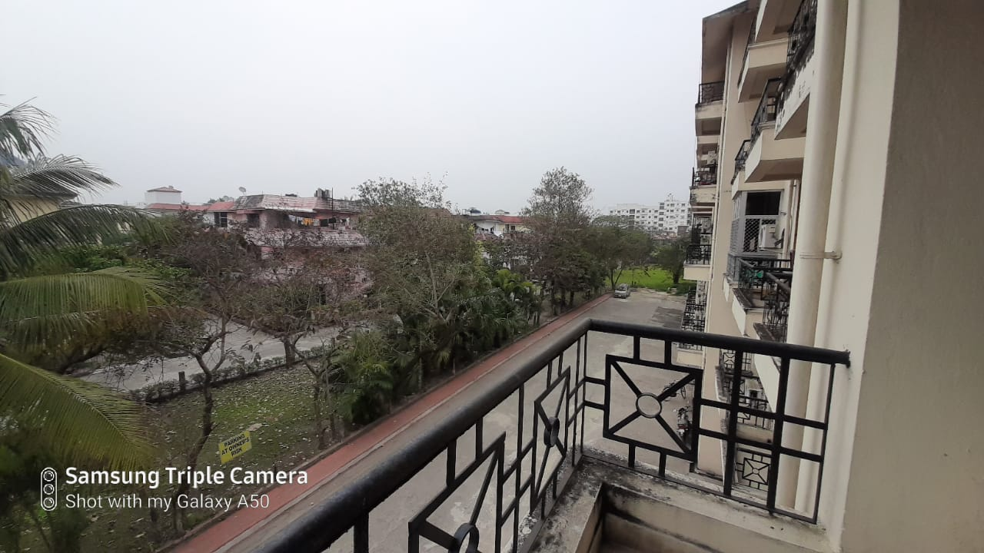
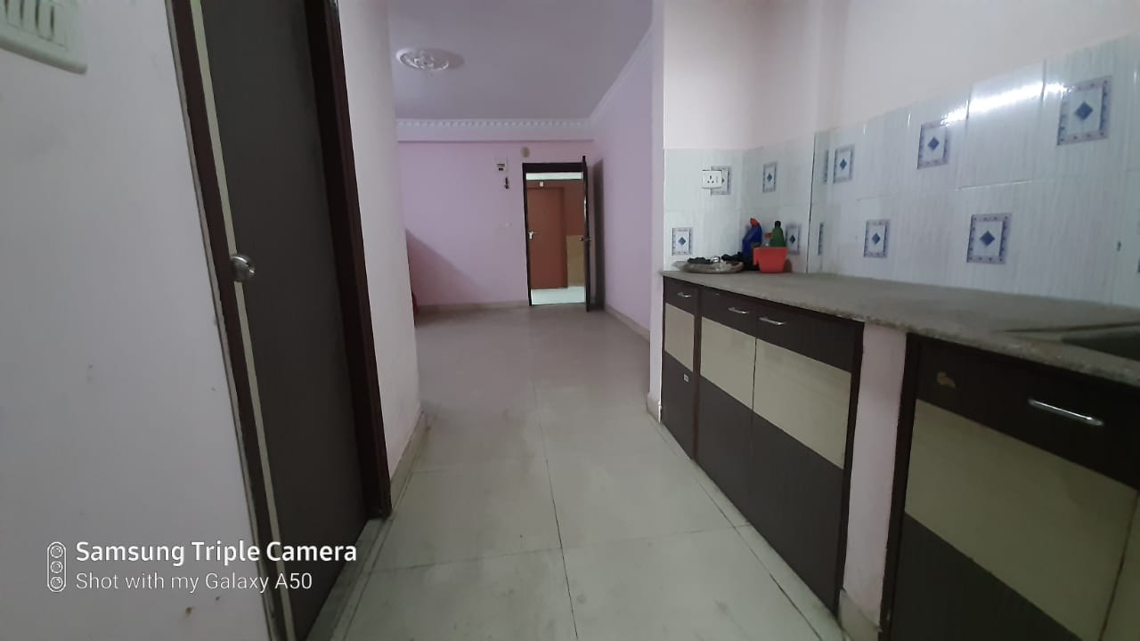
Property Images
* Map Not to Scale
Page 6

Slide 7
Contact Information
Arnab Roy Karmakar CBRE South Asia Pvt. Ltd.
Unit No.702, 7th Floor | PS Pace 1/1 Mahendra Roy Lane | Kolkata 700046, India
Mobile – 91 8017055009
Arnab.Roy@cbre.com | www.cbre.com
OR
Adnan Faisal CBRE South Asia Pvt. Ltd.
Unit No.702, 7th Floor | PS Pace 1/1 Mahendra Roy Lane | Kolkata 700046, India
Mobile – 91 7003317797
Adnan.Faisal@cbre.com | www.cbre.com
OR
Gaurav Das
mjunction services limited
Godrej Waterside, 3rd Floor, Tower 1, Plot V
Block DP, Sector V, Salt Lake, Kolkata - 700091.
Mobile : +91 8584008249
gaurav.das@mjunction.in
Please Contact :
DISCLAIMER: All inspections of property shall be arranged with prior notice of at least 24 hours, Inspections will be conducted between 10 AM – 5 PM. The information contained herein (the "Information") is intended for informational purposes only and should not be relied upon by recipients hereof. Although the Information is believed to be correct, its accuracy, correctness or completeness cannot be guaranteed and has not been verified by either CBRE South Asia Pvt. Limited or any of its affiliates (CBRE Limited and its affiliates are collectively referred to herein as "CBRE"). CBRE neither guarantees, warrants nor assumes any responsibility or liability of any kind with respect to the accuracy, correctness, completeness or suitability of or decisions based upon or in connection with, the Information. The recipient of the Information should take such steps as the recipient may deem appropriate with respect to using the Information. The Information may change and any property described herein may be withdrawn from the market at any time without notice or obligation of any kind on the part of CBRE. Potential purchaser should not rely on any material contained in this brochure as a statement or representation of fact but should satisfy themselves as to its correctness by such independent investigation as they or their legal and or financial advisors deem fit.

